Slide 1

SMART INDIA HACKATHON 2026
GUARDIANS
SEE | TRACE | PROTECT OUR OCEANS
Problem Statement ID : 26143
Problem Statement Title
Leveraging satellite imagery to determine oil spills at sea along with AIS data correlations to identify the vessel responsible for the spill
Theme : Disaster Management
PS Category: Software
Team ID: BMS/SIH2026/124
Team Name: Who Spilled it

Slide 2
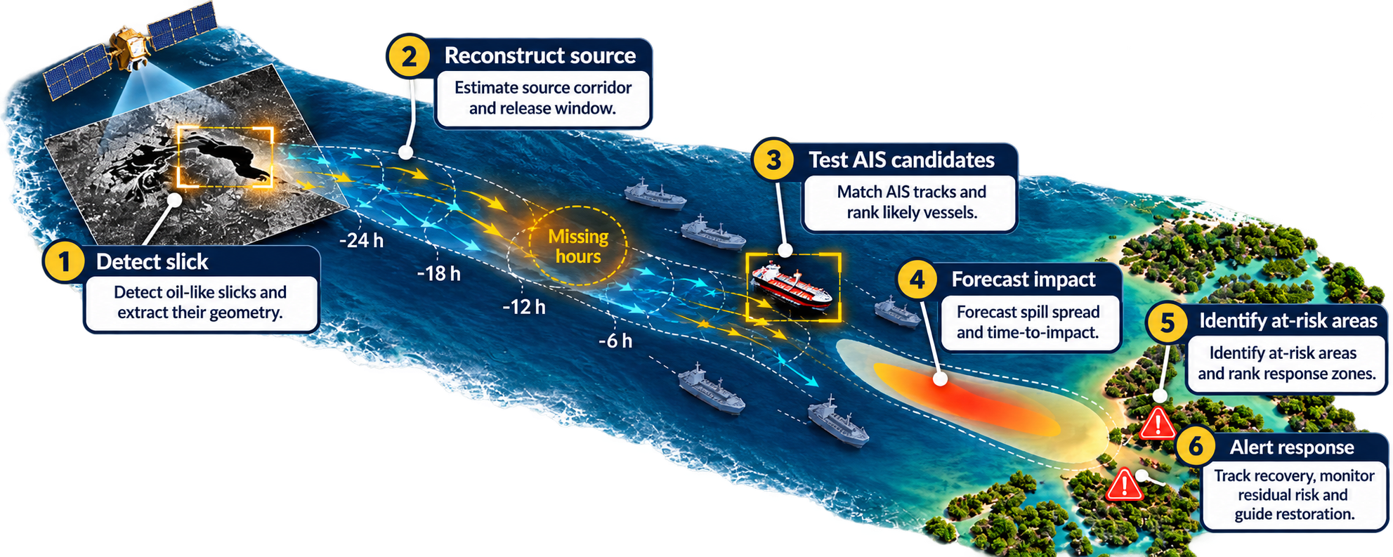
Who Spilled It
Proposed Solution - Guardians
Real World Problem
Innovation and Uniqueness:
Oil spills are hard to detect early easily confused with look-alikes.
Currents and winds move oil and make it hard to find source.
Bidirectional Verification: Hindcasts slick origin; forward-simulates releases from candidate vessels.
Deterministic & Auditable: Same inputs give repeatable results with traceable evidence.
Edge-Ready AI: Lightweight ResNet-18 enables low-power/offline inference.
Offline-First Resilience: Uses cached environmental and AIS data with limited connectivity.
Modular Engine: Detection, attribution, forecasting, and response work independently or together.
Response Intelligence: Converts detection into impact forecasts and protection priorities.
Why Important
Early detection and tracing can stop oil before it harms coasts
and marine life. Identifying the source enables faster response and accountability.
Proposed Solution:
An end-to-end oil-spill intelligence system
combining SAR imagery, AIS tracks,
wind/current data, AI slick detection,
source reconstruction, vessel attribution,
and forward-drift forecasting.
It detects probable spills, reconstructs
where and when they originated, ranks
candidate vessels with traceable evidence,
predicts future spread, and supports response
planning.
@SIH Idea submission- Template

Slide 3
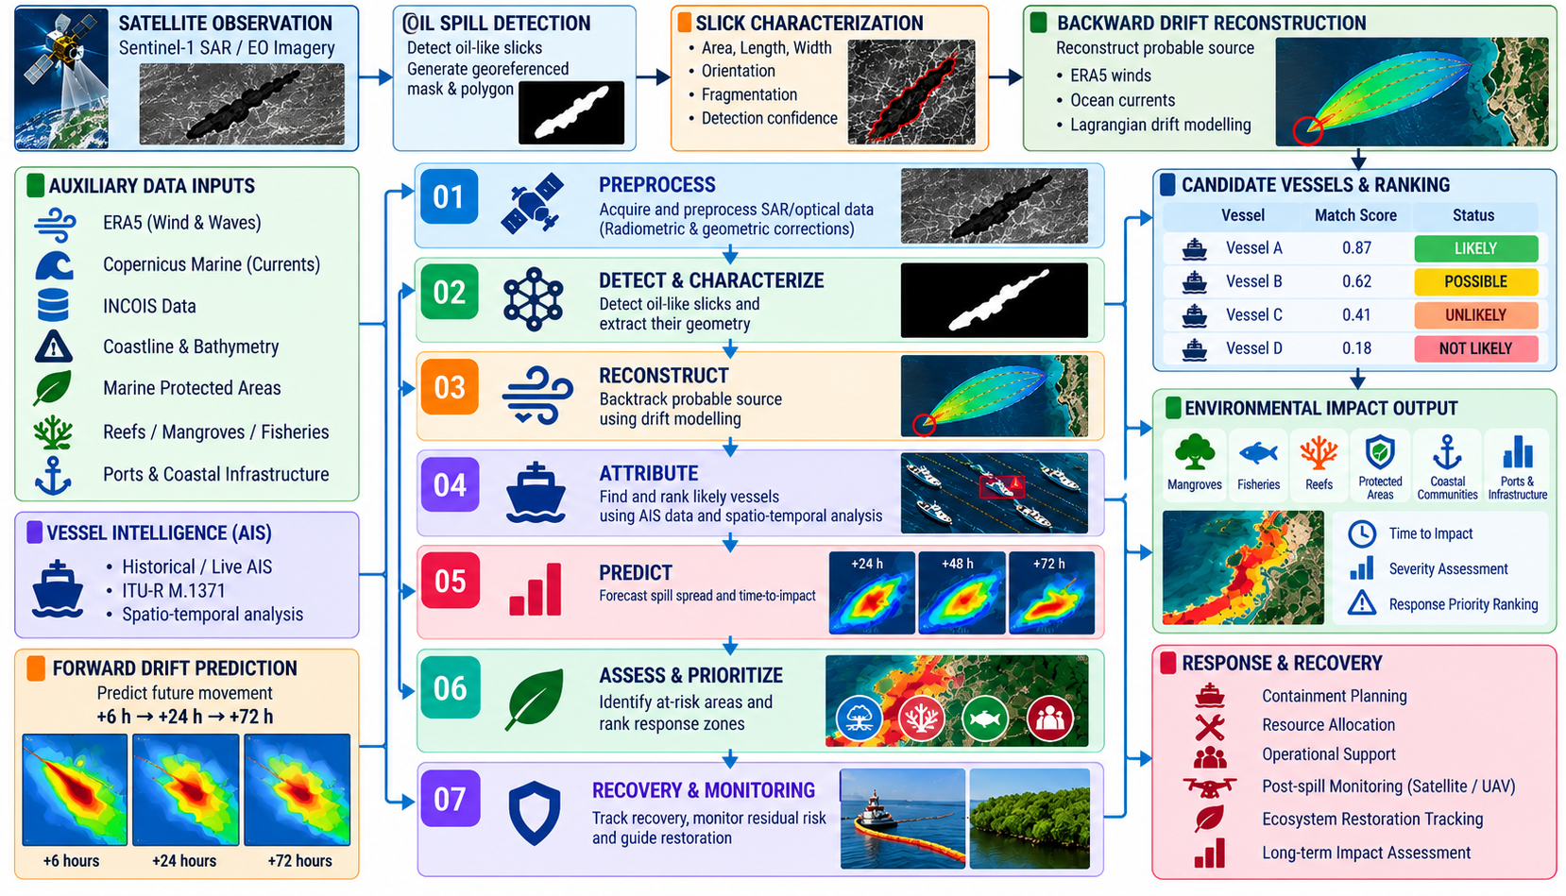
Who Spilled It
Technical Approach
Technology Stack
Satellite & Remote Sensing
Sentinel-1 SAR (VV/VH), Sentinel-2
Copernicus Data Space
AI / Computer Vision
TerraMind Large , DeepLabV3+,
PyTorch
Ocean & Atmospheric Data
ERA5 , Copernicus Marine
INCOIS, Lagrangian Drift Modelling
Vessel Intelligence (AIS)
Historical / Live AIS
ITU-R M.1371
Spatio-temporal Track Analysis
Backend & Geospatial
Python, FastAPI, PostGIS
GeoPandas, GDAL
Visualization & Interface
CesiumJS , React
Mapbox / Deck.gl

Slide 4
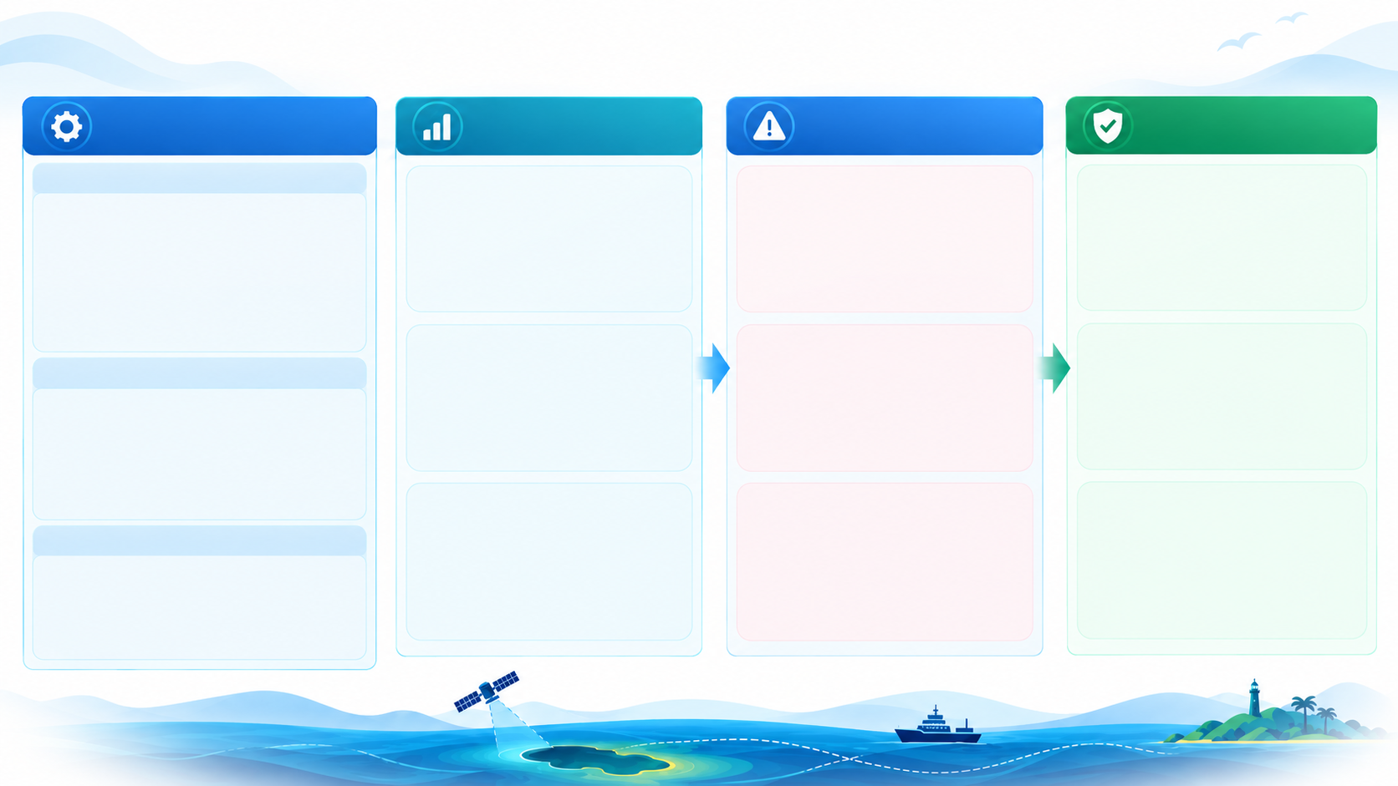
Who Spilled It
Feasibility and Viability

Slide 5
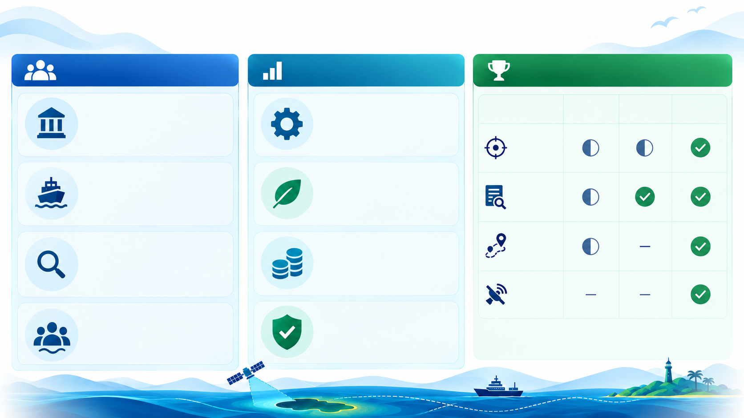
Who Spilled It
Impacts and Benefits
Who Benefits
Value Created
Why “GUARDIANS”
Maritime Authorities

Slide 6
Who Spilled It
Research and References
Data sources
Sentinel-1 / Satellite
https://dataspace.copernicus.eu/data-collections/copernicus-sentinel-missions/sentinel-1
https://dataspace.copernicus.eu/
https://sentinels.copernicus.eu/sentinel-data-access
Sentinel-1 Oil Spill Datasets
https://zenodo.org/records/8346860
https://zenodo.org/records/8253899
https://zenodo.org/records/13761290
https://www.kaggle.com/datasets/harikrishnacs/sentinel-1-sar-oil-spill-detection-dataset
Weather / Wind
https://cds.climate.copernicus.eu/datasets/reanalysis-era5-complete?tab=d_download
https://cds.climate.copernicus.eu/datasets/reanalysis-era5-single-levels?tab=download
Ocean Currents / Marine Data
https://data.marine.copernicus.eu/
https://data.marine.copernicus.eu/product/INSITU_GLO_PHY_UV_DISCRETE_NRT_013_048/services
INCOIS
https://www.incois.gov.in/
https://www.do.incois.gov.in/
AIS / Vessel Data
https://ocmgeodatastor1.blob.core.windows.net/marinecadastre/ais/aistrack/index-aistrack.html
https://www.fisheries.noaa.gov/inport/item/79504
https://globalfishingwatch.org/our-apis/
https://globalfishingwatch.org/our-apis/documentation/
https://api-doc.globalfishingwatch.org/our-apis/documentation/docs/v3/vessels
https://zenodo.org/records/14982712
Environmental Impact Layers
https://www.protectedplanet.net/en/thematic-areas/wdpa
https://allencoralatlas.org/resources/
https://resources.unep-wcmc.org/products/aaa46cd3d3d640b2916b8f0a0ffe07cb
https://www.naturalearthdata.com/downloads/10m-physical-vectors/
https://www.naturalearthdata.com/downloads/10m-physical-vectors/10m-coastline/
https://response.restoration.noaa.gov/esi
https://www.fisheries.noaa.gov/inport/item/40881
Papers / Methods
https://www.sciencedirect.com/science/article/pii/S0025326X24005265
https://pubmed.ncbi.nlm.nih.gov/38850755/
https://openaccess.thecvf.com/content_ECCV_2018/html/Liang-Chieh_Chen_Encoder-Decoder_with_Atrous_ECCV_2018_paper.html
https://openaccess.thecvf.com/content/ICCV2025/html/Jakubik_TerraMind_Large-Scale_Generative_Multimodality_for_Earth_Observation_ICCV_2025_paper.html
https://arxiv.org/abs/2504.11171
https://opendrift.github.io/
https://github.com/OpenDrift/opendrift
https://www.itu.int/rec/R-REC-M.1371
https://essd.copernicus.org/articles/17/6807/2025/
https://zenodo.org/records/3497132
https://doi.org/10.3390/rs11151762
https://zenodo.org/records/2541694

